Slide 1
Class 5
Exchange Rates by
Alan V. Deardorff
University of Michigan
2022
PubPol/Econ 541

Slide 2
Outline
Exchange markets: What they are
Supply and Demand
Two Simple Theories
Pegged Exchange Rates

Slide 3
Exchange Market
Exchange rate is
  Price of one currency in terms of another
    E.g., $/£ or £/$

Slide 4
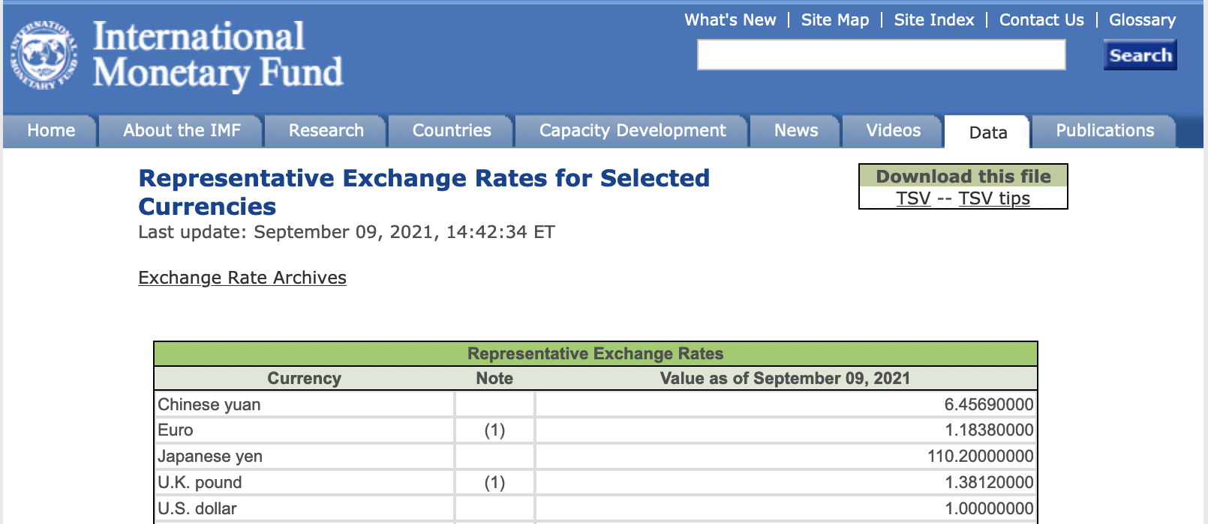
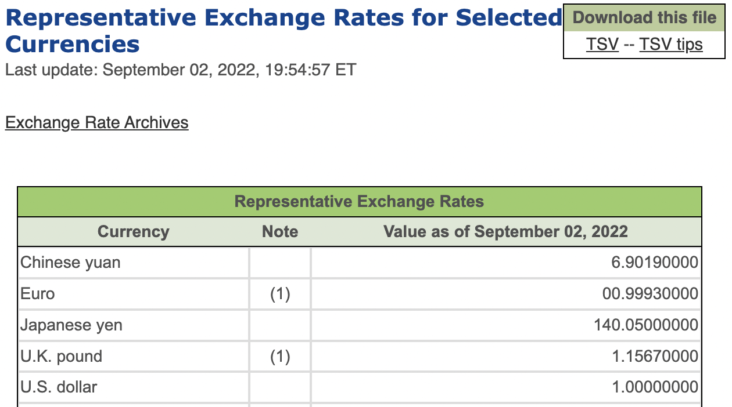

Notes:
https://www.imf.org/external/np/fin/data/rms_rep.aspx

Slide 5
Pause for Discussion

Slide 6
  Questions on KOM, Ch 14
Is an exchange rate the price of one country’s goods in terms of another’s, or the price of one country’s assets in terms of another’s?
On what transactions are reported rates based?
What hours of the day are the exchange markets open?

Slide 7
Exchange Market
Types of exchange rate
  Spot
    For exchange of currencies today
  Forward
    For exchange of currencies 30, 60, 90 etc. days from the present
    Both payment and receipt happen then, not now
  Futures –
    Like forward market, but for specific calendar dates in future

Slide 8
Exchange Market
Types of exchange rate, continued
  Bilateral
    For exchange of 2 currencies
  Trade weighted
    For one currency relative to multiple others
    An average, or index
  Real
    Adjusted for inflation, both at home and abroad

Slide 9
Source: Federal Reserve, “Broad Index” based on a large group of currencies, monthly data
Notes:
https://www.federalreserve.gov/releases/h10/summary/jrxwtfb_nm.htm
Dollar Index Broad.xlsx
[This from 2021 course. Didn’t update.]

Slide 10
Source: Federal Reserve, “Broad Index” based on a large group of currencies, monthly data
Notes:
https://www.federalreserve.gov/releases/h10/summary/jrxwtfbc_nm.htm
Dollar Index Broad.xlsx
[This updated to 2022 from OLLI lecture.]

Slide 11
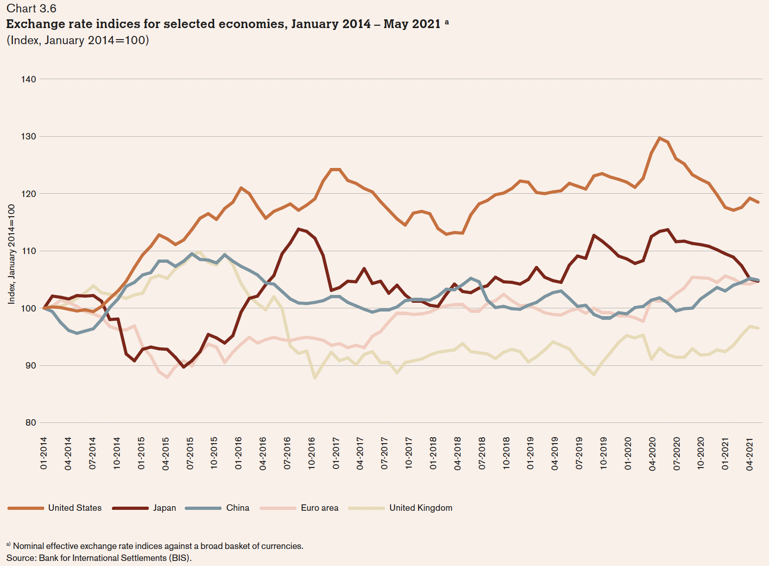
US $
Japan
Euro €
China
UK £
01-2014
04-2021
Notes:
World Trade Organization, Chapters II and III of World Trade Statistical Review 2021, pp. 10-39.
https://www.wto.org/english/res_e/statis_e/wts2021_e/wts2021_e.pdf
[Volume for 2022 not yet available.]

Slide 12
Exchange Market
Who uses the exchange market
  Traders in both goods and services
    Travelers (but that’s trade)
  International borrowing, lending, and asset trade
  Speculators
    Buyers or sellers who hope to profit from future exchange-rate change
  Hedgers
  Arbitragers

Slide 13
Pause for Discussion

Slide 14
  More Questions from KOM
What is “arbitrage” in the foreign exchange market?
What is “hedging” in the foreign exchange market?
What role does the US dollar play in international finance?

Slide 15
Supply and Demand for Foreign Exchange
Questions:
Who demands €?
Who supplies €?
Market Model:
E ($/€)
S€
E₀
D€
Q€

Slide 16
Exchange Market
Traders respond to
  Prices of goods
    Rise in home prices causes currency to fall
Capital movements respond to
  Interest rates
    Rise in home interest rate causes currency to rise
  Expectations
    Expectation of any change causes that change

Slide 17
Two Simple Theories
Asset Theory
  Simple: E is whatever it is expected to be
    If it were not, its expected change would drive capital flows that would swamp the market
  Works best in short run (but not useful)
PPP = Purchasing Power Parity
  Exchange rate reflects the prices of goods
  See Big Mac Index
  Works best in long run

Slide 18
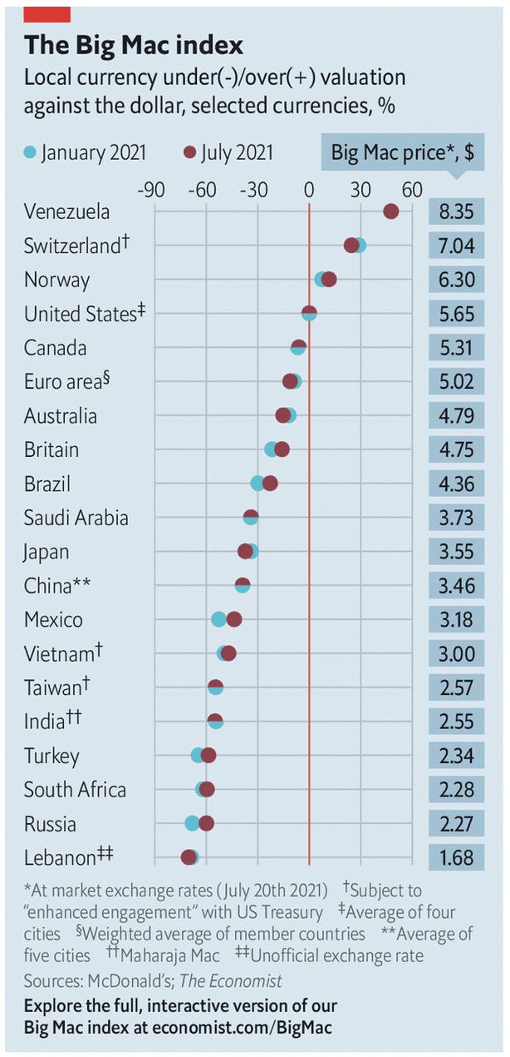
Notes:
Economist, “The Big Mac index: What the Big Mac index says about the dollar and the dong,” The Economist, July 24, 2021.
https://www.economist.com/finance-and-economics/2021/07/24/what-the-big-mac-index-says-about-the-dollar-and-the-dong

Slide 19
Pause for Discussion

Slide 20
  Questions on Economist,
  “Big Mac index”
On what basis does this article rank countries?
Why does this article focus on the Vietnamese currency, the dong?
What criteria does the US Treasury use to identify an undervalued currency?
Is Vietnam’s poverty relevant to this?

Slide 21
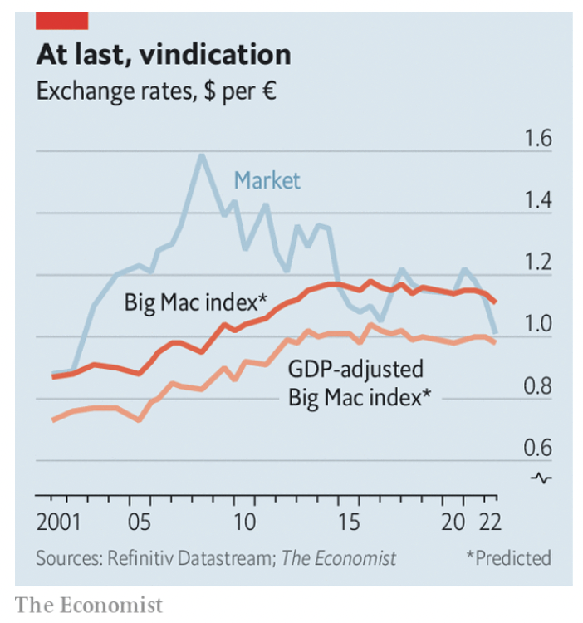
Euro exchange rate: Market and Big Mac compared.

Slide 22
  Questions on Economist,
  “Dollar-euro parity…”
What are UIP and PPP?
Why does a rise in the US interest rate cause the dollar to rise in value?
If people see a higher expected return on assets in the US than abroad, how does a rise in the exchange rate cause that expected return to fall?
Why does The Economist adjust for GDP? They don’t say, but do you think this is total GDP or GDP per capita?

Slide 23
Pegged Exchange Rates
Bretton-Woods System
  Successor to the Gold Standard
  Most currencies pegged to US $
How to peg
  Need “reserves” of foreign currency
  Use them to buy or sell own currency as needed
Does it work? Yes and no

Slide 24
Pause for Discussion

Slide 25
  Questions on Economist, “…Bretton Woods…”
What names and characteristics describe the three international monetary regimes that the Economist article describes, the last of which may be coming to an end?
Why did the world not shift to using dollars, euros, and renminbi more equally for transactions and reserves?
Why is currency stability so hard to achieve?

Slide 26
  Questions on Mackintosh
What is a “reverse currency war” and what would be a normal one?
Is there evidence here that other countries are competing with the US to raise their currencies’ values?
What pain does a weak currency cause?

Slide 27
Some Recent Exchange Rate Movements
From X-rates.com
US $ per country currency

Slide 28
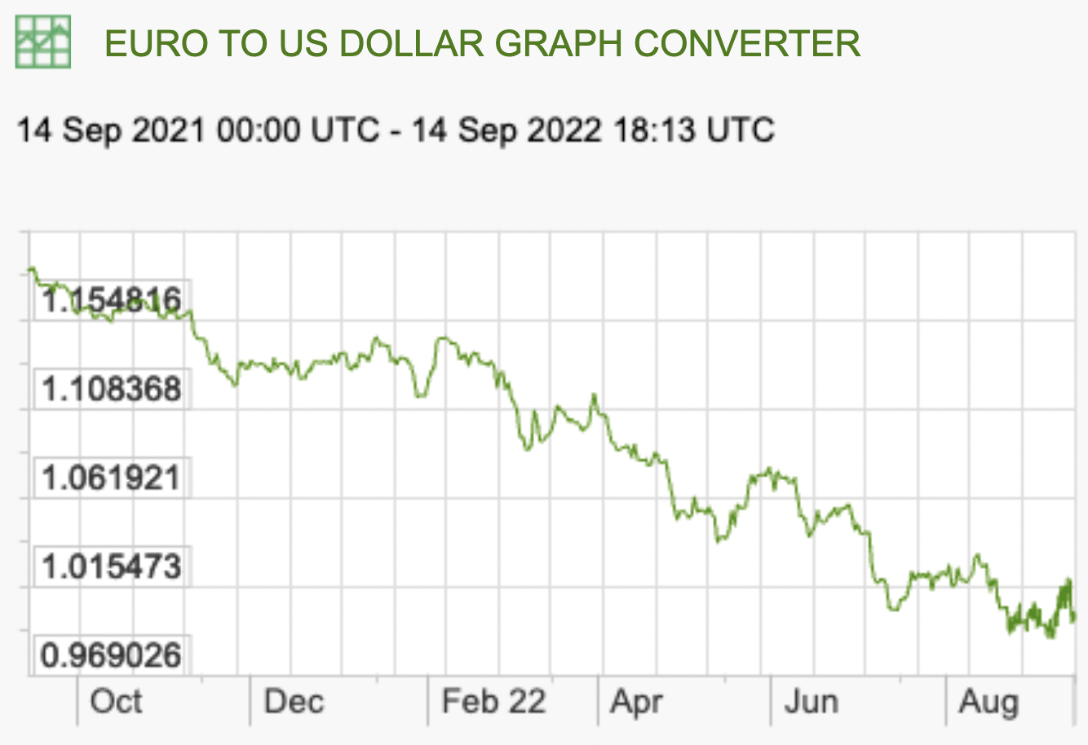
Recent Rate Movements: Euro
Notes:
https://www.x-rates.com/graph/?from=RUB&to=USD&amount=1

Slide 29
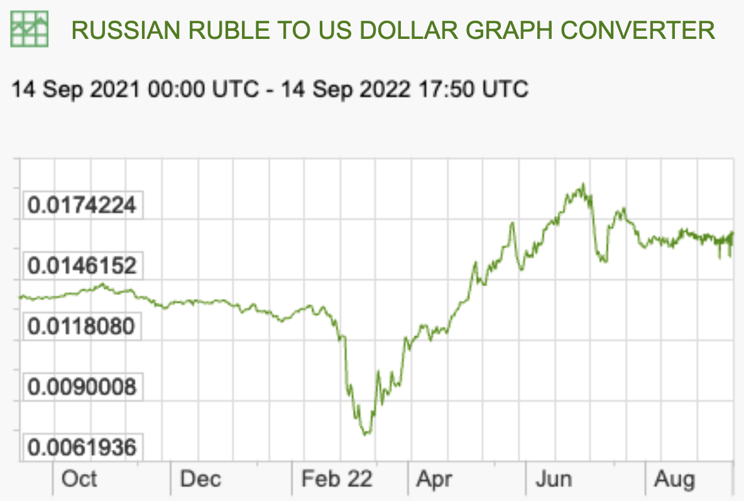
Recent Rate Movements: Russia
Notes:
https://www.x-rates.com/graph/?from=RUB&to=USD&amount=1

Slide 30
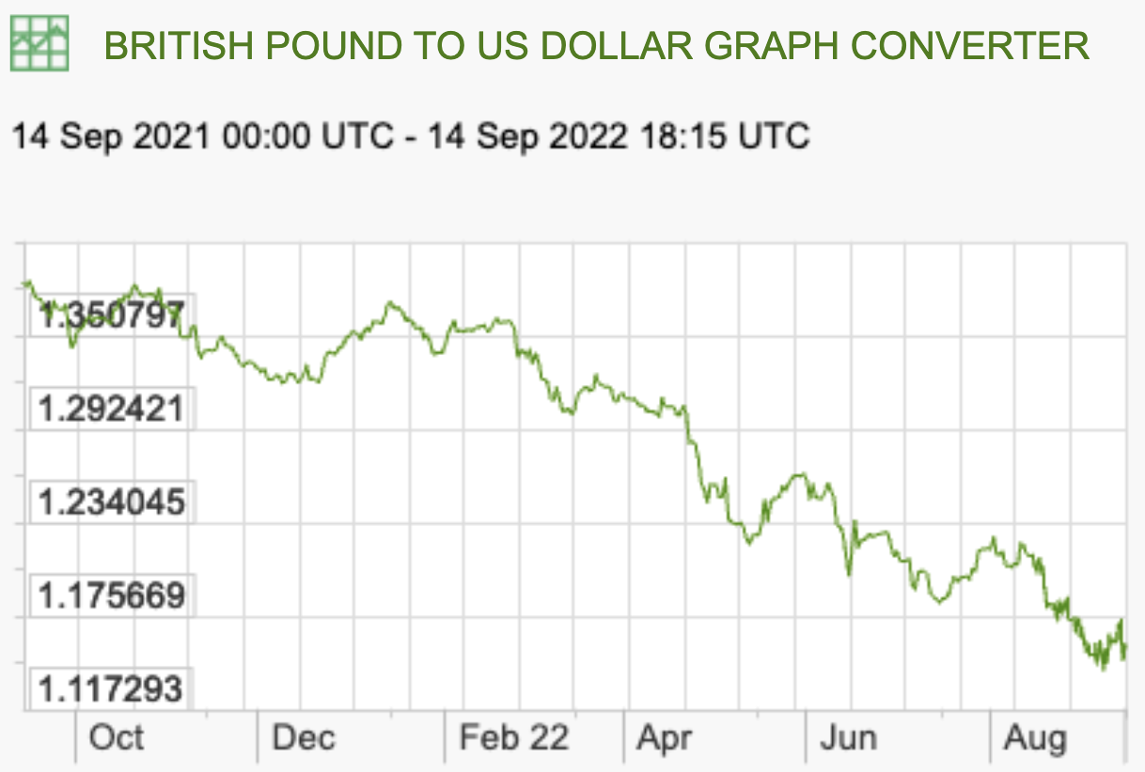
Recent Rate Movements: UK
Notes:
https://www.x-rates.com/graph/?from=RUB&to=USD&amount=1

Slide 31
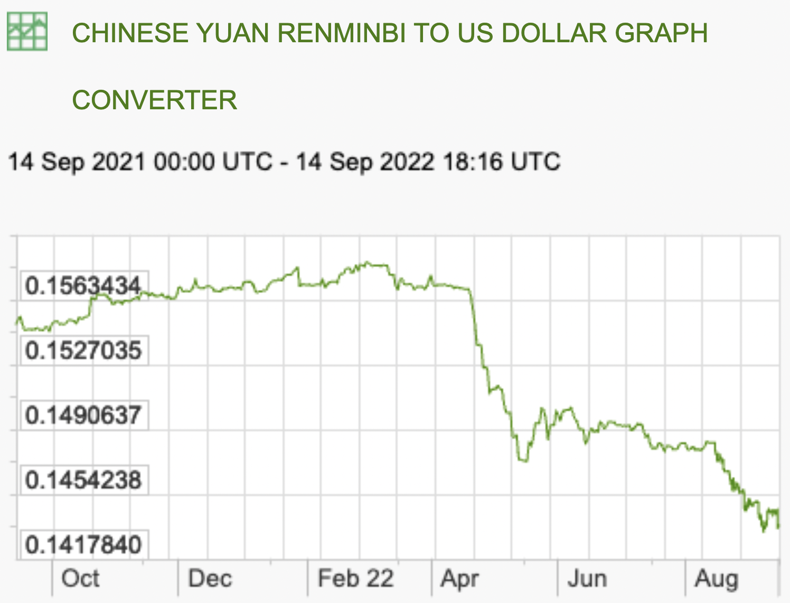
Recent Rate Movements: China
Notes:
https://www.x-rates.com/graph/?from=RUB&to=USD&amount=1

Slide 32
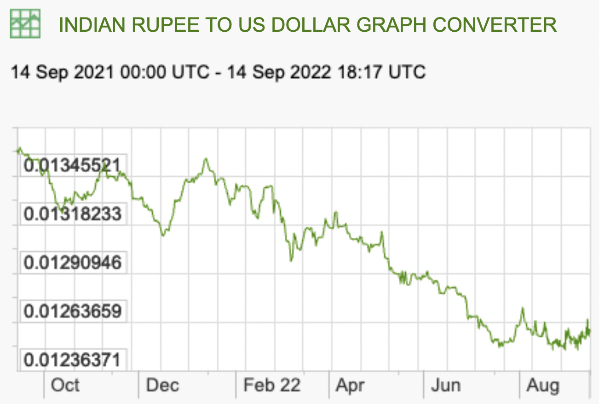
Recent Rate Movements: India
Notes:
https://www.x-rates.com/graph/?from=RUB&to=USD&amount=1

Slide 33
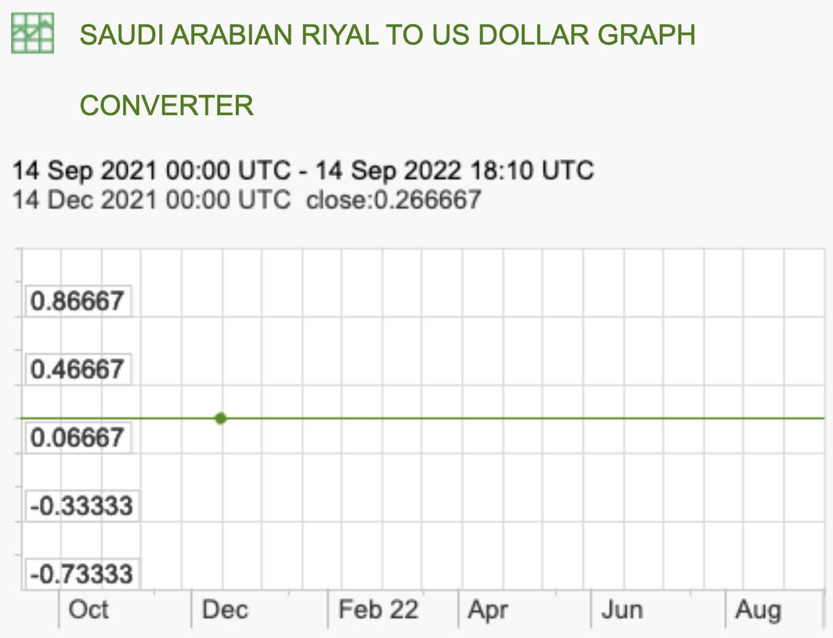
Recent Rate Movements: Saudi Arabia
Notes:
https://www.x-rates.com/graph/?from=RUB&to=USD&amount=1

Slide 34
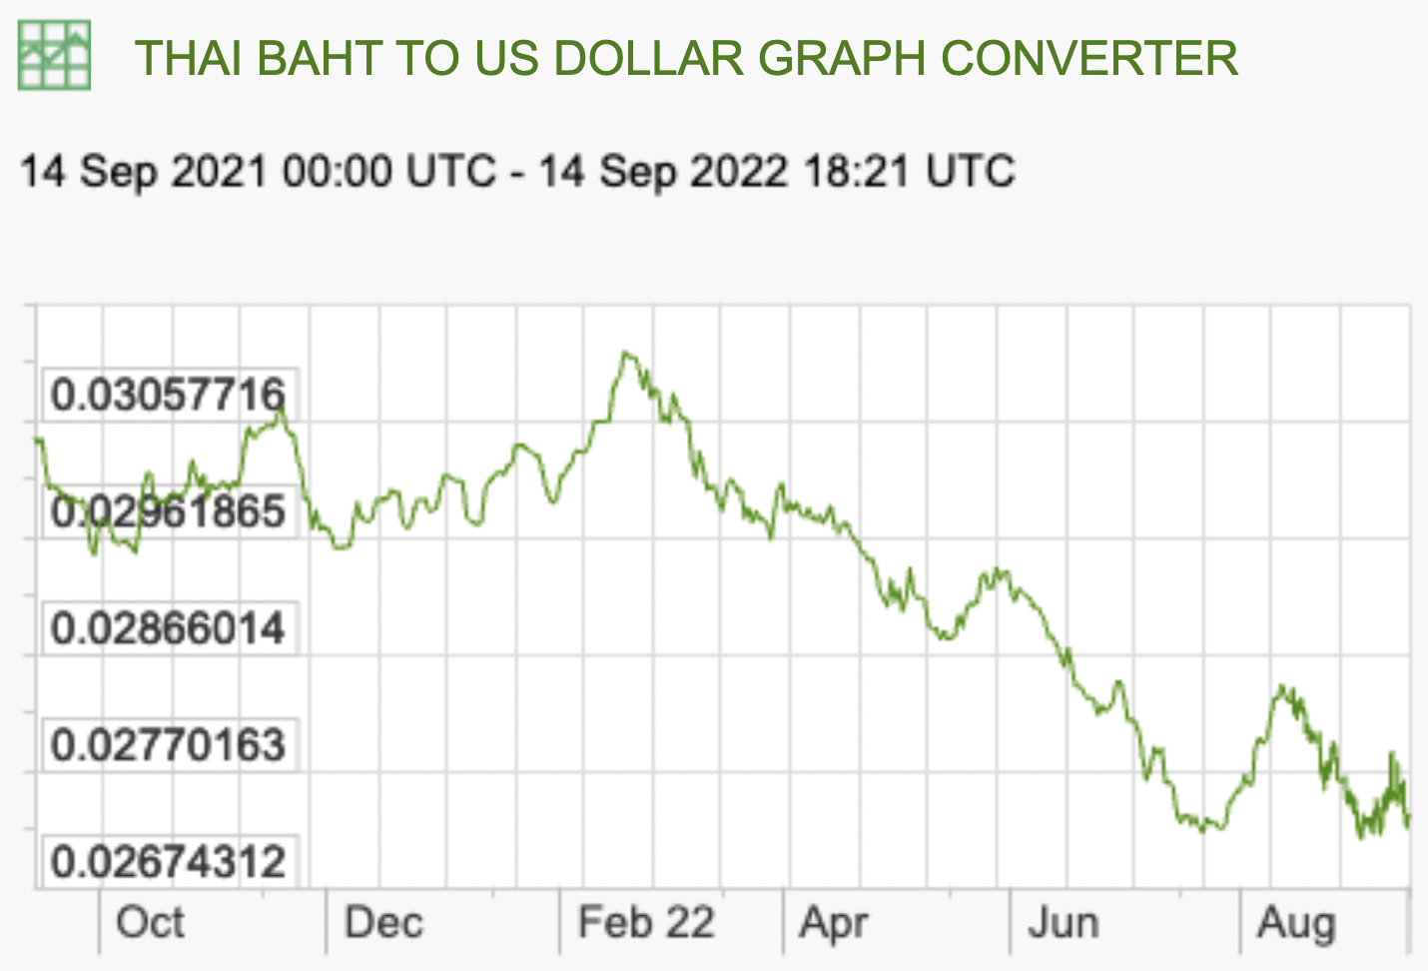
Recent Rate Movements: Thailand
Notes:
https://www.x-rates.com/graph/?from=RUB&to=USD&amount=1

Slide 35
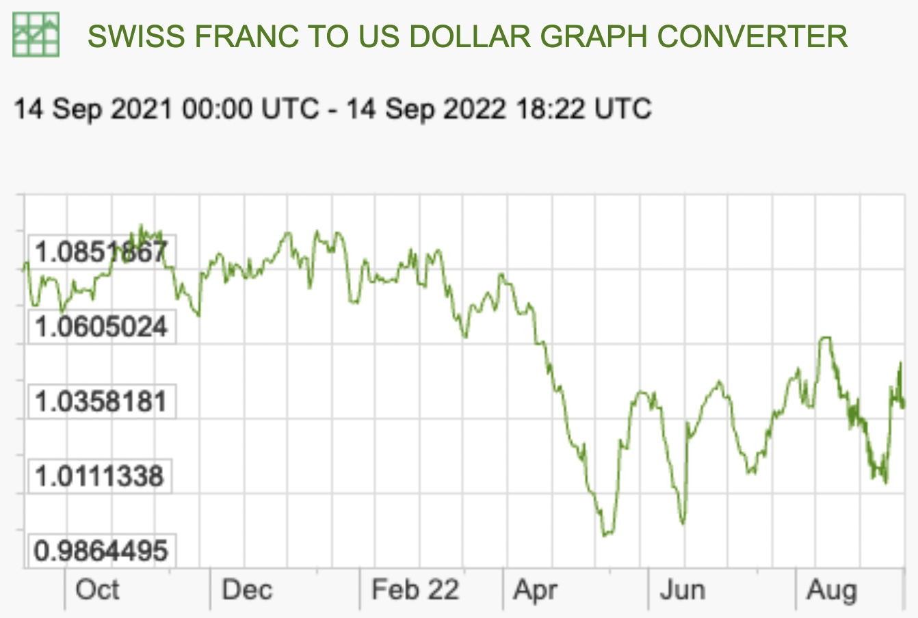
Recent Rate Movements: Switzerland
Notes:
https://www.x-rates.com/graph/?from=RUB&to=USD&amount=1

Slide 36
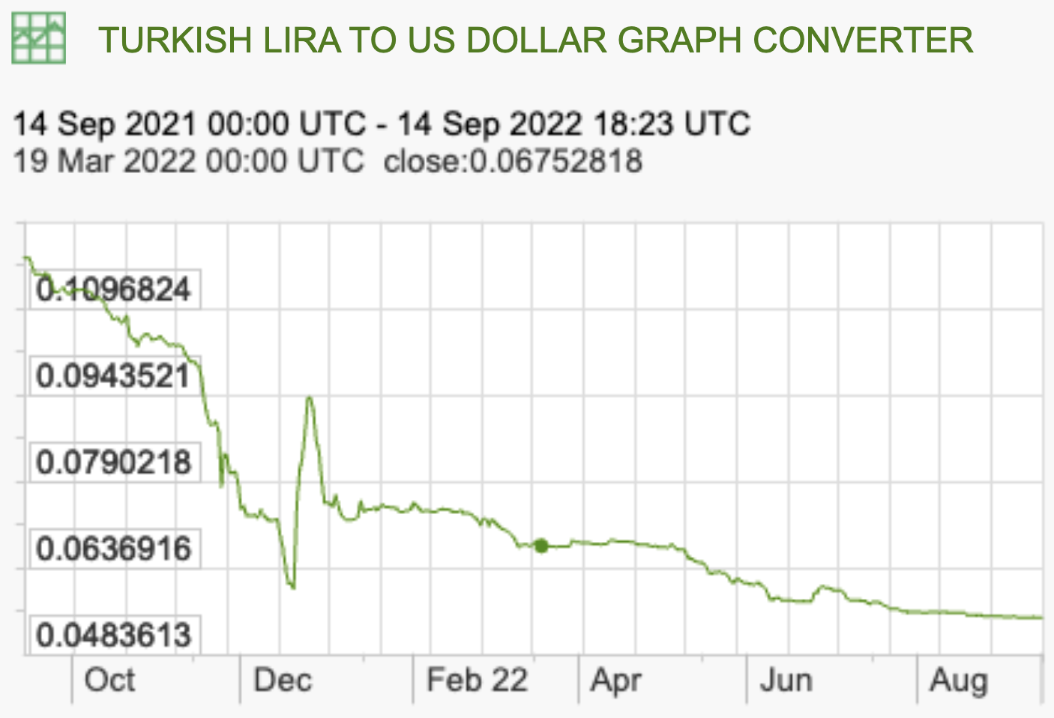
Recent Rate Movements: Turkey
Notes:
https://www.x-rates.com/graph/?from=RUB&to=USD&amount=1

